Slide 1
IBM Data Science Professional Certificate Capstone Project Report Aykut Atakan 05 JUN 2019

Slide 2
Introduction and Business Problem
Ekrem wants to open a burger restaurant in Warsaw, Poland.
Warsaw has 18 districts and we are deciding which districts is more suitable for Ekrem to open the restaurant
Ekrem wants to consider other burger restaurants, number of high schools, number of universities and number of Office in determining the location.

Slide 3
Data Sources
Districts are taken from Wikipedia.org
The coordinates (latitude, longitude) of these districts of Warsaw are from Open Street Map APIs
Venue data is pulled from foursquare API.

Slide 4
Methodology
For each locality, all office, school, university and burger restaurant venues data have been collected from Foursquare.
Then for each locality, the sums of the office, school, university and burger joints were computed.

Slide 5
Methodology
3. For each of this 4 categories, a weight (or penalty) has been defined according to what Ekrem considers the most important.
Burger Joints have been weighted with -1, since Ekrem wants to avoid concurrence.
Schools have been weighted with 1, since student are good customers.
Universities have been weighted with 1.5, since students are good customers.
Offices have been weighted with 2, since employees are even better customers.

Slide 6
Methodology
Note that the weights can be modified according to the importance of each category.
Lastly, a score was computed for each locality as the weighted sum of the number of venues in each of the 4 categories (school, university, office, burger joints).

Slide 7
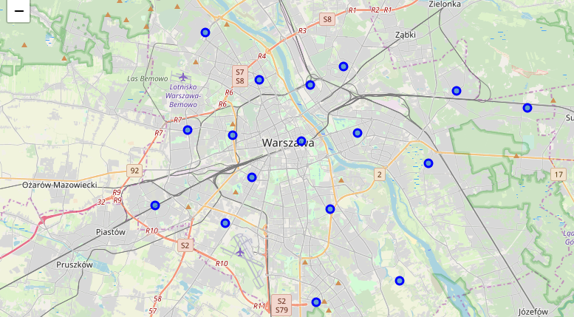
Districts of Warsaw, Poland

Slide 8
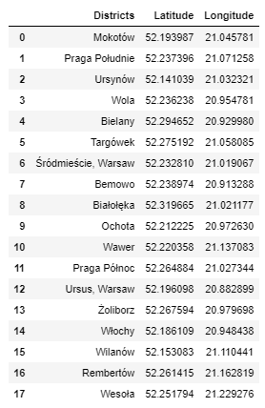
Districts of Warsaw, Poland

Slide 9
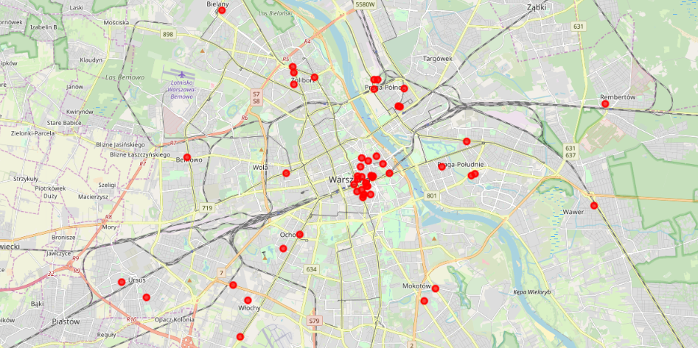
Burger Restaurants

Slide 10
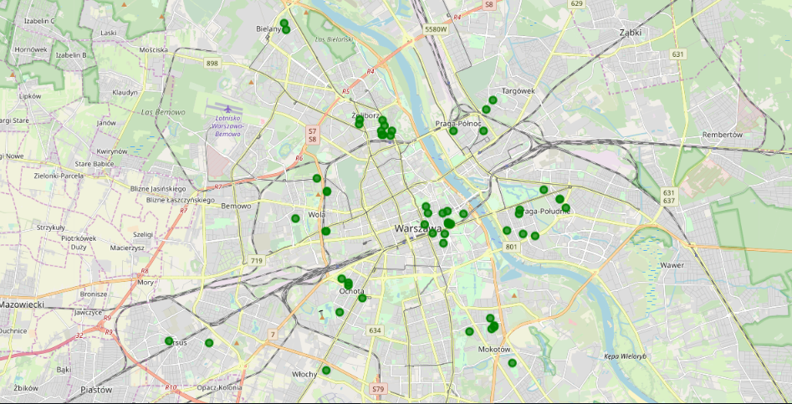
Highschools

Slide 11
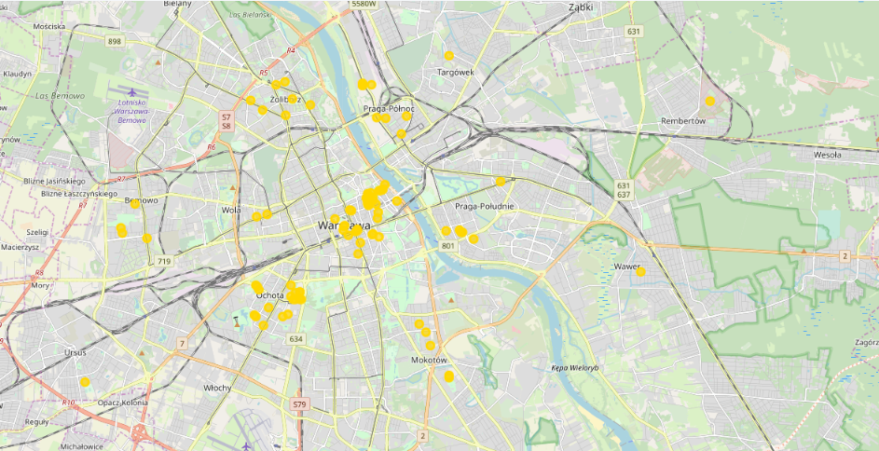
Universities

Slide 12
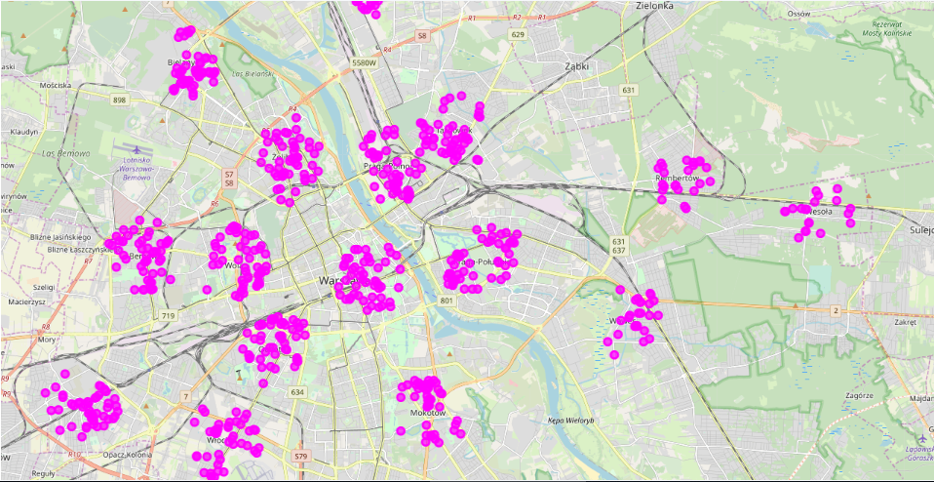
Offices

Slide 13
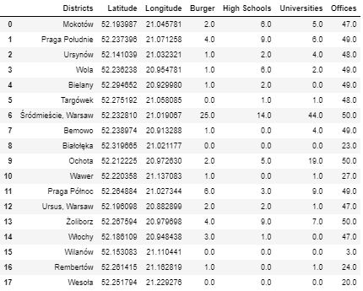
Breakdown

Slide 14
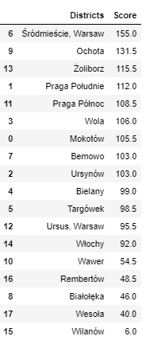
Scores after weighted computation

Slide 15
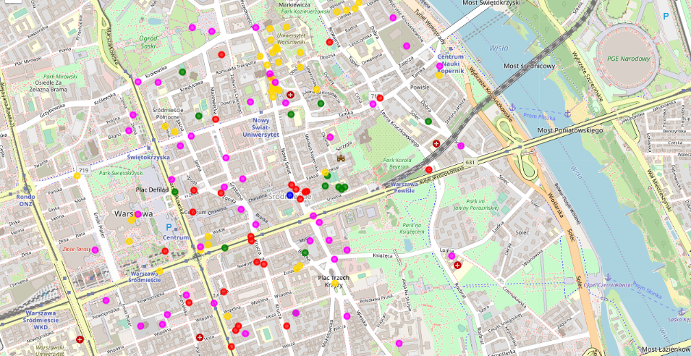
The Locality with the best score is “Śródmieście, Warsaw” with 155.0, being the best option. (blue point)

Slide 16
Recommendations:
The following analysis can be improved with following extensions:
Consider more categories. For example like "Night life" which is also a good source for customers. But also like "Restaurants", which even if not burger joints may be some concurrence if too many.
In the Locality itself, it can also be computed the distance between all the venues in order to find a place with the most number of potential customers.
Using smaller geographical areas like Neighborhoods could improve the accuracy for the scores.

